Slide 1
Computer Organization
TOPIC 2.0 – Computer organization
TOPIC 2
2.1.14: Truth Tables and Boolean Logic

Slide 2
AGenda
THE AGENDA
Warm Up
Truth Table Review
Circuit Diagrams
Circuit Diagram Practice
Venn Diagrams
Venn Diagram Practice

Slide 3

REVIEW REVIEW REVIEW REVIEW REVIEW REVIEW
THE WARM-UP QUESTION
Construct a truth table for the following logical statement
(p^q)v(r^q)

Slide 4
REVIEW REVIEW REVIEW REVIEW REVIEW REVIEW
THE WARM-UP ANSWER
Inputs |  |  |  |  | Output
p | q | r | p^q | r^q | (p^q)v(r^q)
F | F | F | F | F | F
F | F | T | F | F | F
F | T | F | F | F | F
F | T | T | F | T | T
T | F | F | F | F | F
T | F | T | F | F | F
T | T | F | T | F | T
T | T | T | T | T | T

Slide 5
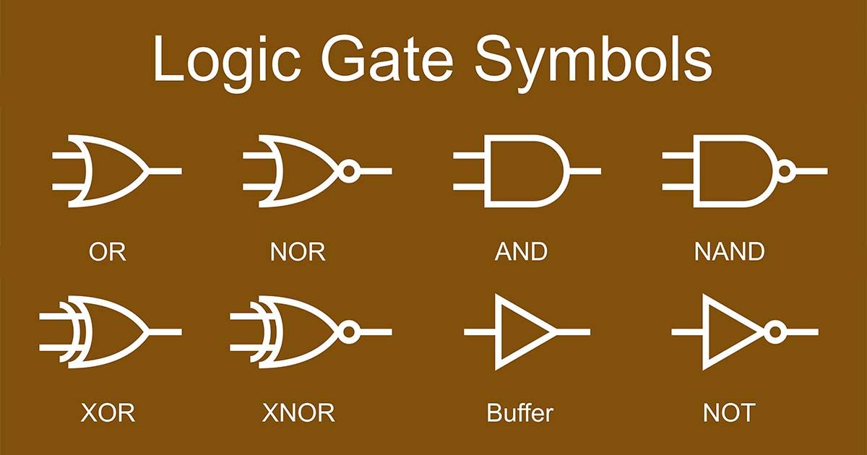
TOPIC 2.1.13 – Logic diagrams
Logic diagrams
To fully create a computer we use many electrical circuits
These circuits take binary input and produce a single binary output
We implement these using the logic gates we discussed in the lesson before last

Slide 6
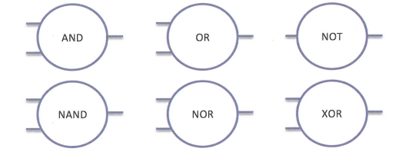
TOPIC 2.1.13 – logic diagrams
Logic diagrams
To communicate these, we can use the symbols below, but it is often easier to use a circle indicating which gate is used

Slide 7
TOPIC 2.1.13 – Logic diagrams
Logic diagrams
Let’s look at an example:
If it is raining and not cold outside, I will bring a rain coat
p ^ ~q
AND
Raining
Wear rain coat
NOT
Cold

Slide 8
TOPIC 2.1.13 – Logic diagrams
Logic diagrams
Let’s try another example
If I have a doctor’s appointment and an excuse note, or if it is after 4 o’clock, I will go to the doctor
(p ^ q) v (~r)
AND
OR
Appointment
Go to doctor
Excuse Note
NOT
After 4

Slide 9
TOPIC 2.1.13 – Logic diagrams
Logic diagrams Practice
Your turn!
I will eat the food if it is not spicy and salty, or sweet

Slide 10
TOPIC 2.1.13 – Logic diagrams
Logic diagrams
Notice the way that one input can go to two conditions
If my car’s tire is flat and I have a pump, or if my tire is filled, I will go to work
(p ^ q) v (~q)
AND
I have a pump
Tire is flat
OR
NOT
I will go to work

Slide 11
TOPIC 2.1.13 – Logic diagrams
Logic diagrams Practice
Your turn!
The alarm will sound if the window is open or if the door is open, but not if both are open at the same time

Slide 12
TOPIC 2.1.13 – Logic diagrams
Logic diagrams Practice
One more!
The alarm will sound if the window is open or if the door is open, but not if both are open at the same time

Slide 13
TOPIC 2.1.13 – Logic diagrams
Venn diagrams
A student is a varsity athlete if they play both soccer and basketball
p ^ q
soccer
basketball

Slide 14
TOPIC 2.1.13 – Logic diagrams
Venn diagrams
A movie is my favorite if it is an action or an action-comedy, but not a comedy
p v (p ^ q)
action
comedy

Slide 15
TOPIC 2.1.13 – Logic diagrams
Venn diagrams
You can sit at the popular kids table if you are in band and drumline or are in theater
(p ^ q) v r
theater
drumline
band

Slide 16
TOPIC 2.1.13 – Logic diagrams
Venn diagrams
Your turn!
You can do a triathlon if you can bike, swim, and cycle

Slide 17
TOPIC 2.1.13 – Logic diagrams
Venn diagrams
Your turn!
If your car has a functioning seat belt and airbag, or a functioning seatbelt and brakes, you can drive it

Slide 18

TOPIC 2.0 – computer organization
Vocab to remember
Venn Diagram
Circuit Diagram

